Slide 1
ASSESSMENT PLAN
Presented by:

Slide 2
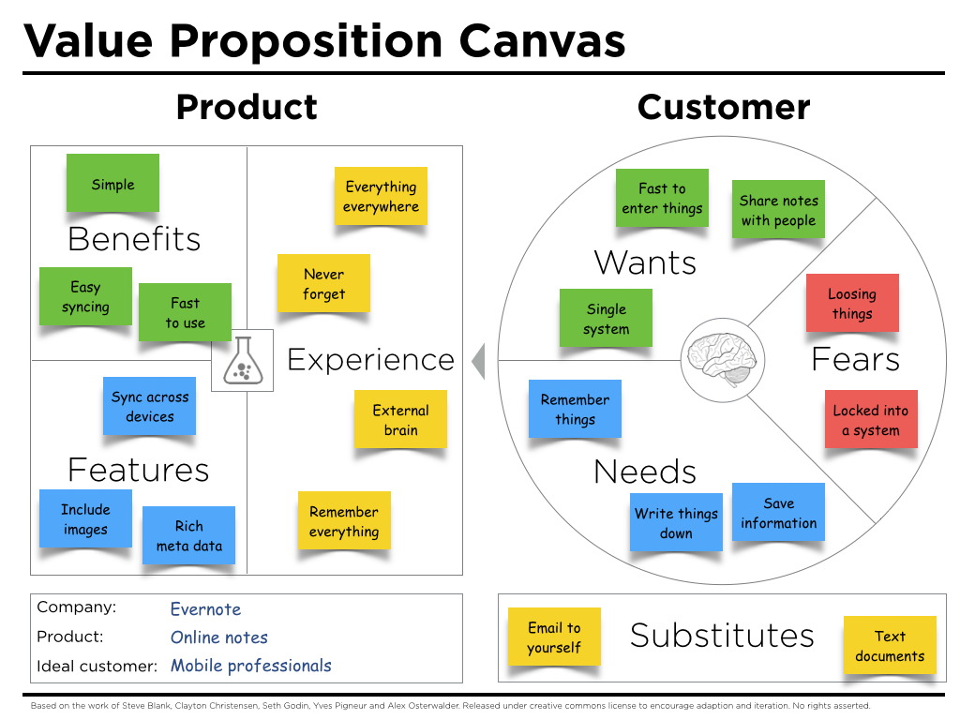
FIRM’S VALUE PROPOSITION
Notes:
Eliminate; Redundancies
Reduce Features; Rich Meta-data by include images, sync across devices.
Raise; Product Benefits e.g., Fast to use, Easy Syncing.
Create; Experience; Remember Everything, External brain, Never forget, Everything everywhere.

Slide 3
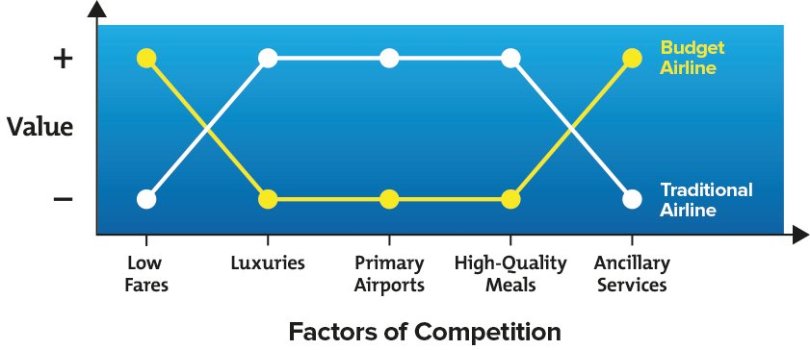
VALUE CURVE
Notes:
The concept of value curves was introduces that an effective strategy needs to have three main factors:
A clear focus.
Divergence from the competition.
A compelling tag line.
The Value Curve model aims to fulfil all of these factors. It provides a useful framework for comparing your strategy against that of your competitors, by using a simple chart. This helps you focus sharply on the things that differentiate you from your competitors, and develop a clear and easily explained value proposition .
Figure, below, shows an example of how value curves can be used to compare strategies. In this example, the value curves represent the strategies used by a budget airline and a traditional airline. The factors on the horizontal axis show the key criteria or "competitive factors" that companies in this industry think are important.
The vertical axis shows the degree to which the budget and traditional airlines invest in, or "value," each of these criteria.
The concept of value curves was introduced in 1997 by academics W. Chan Kim and Renée Mauborgne. They believe that an effective strategy needs to have three main factors:
A clear focus.
Divergence from the competition.
A compelling tag line.
The Value Curve model aims to fulfil all of these factors. It provides a useful framework for comparing your strategy against that of your competitors, by using a simple chart. This helps you focus sharply on the things that differentiate you from your competitors, and develop a clear and easily explained value proposition .
Figure 1, below, shows an example of how value curves can be used to compare strategies. In this example, the value curves represent the strategies used by a budget airline and a traditional airline. The factors on the horizontal axis show the key criteria or "competitive factors" that companies in this industry think are important. The vertical axis shows the degree to which the budget and traditional airlines invest in, or "value," each of these criteria.

Slide 4
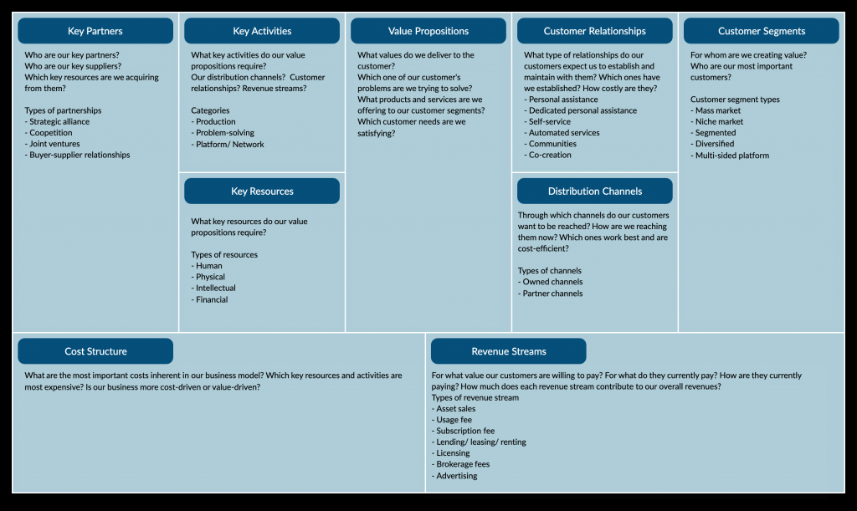
BUSINESS MODEL CANVAS
Notes:
Define; partners, suppliers, key resources
Types of partnerships; Buyer-supplier relationships, joint ventures, competition, strategic alliance
Key activities; Network/Platform, Problem-solving, Production
Key resources; Financial, Intellectual, Physical, Human
Value Proposition; To the customer, problems trying to solve, products/services offered to segments, Needs satisfied
Customer relationships; Type of relationships, co-creation, communities, automated services, self-service, dedicated personal assistance, personal assistance
Distribution channels; Nature of ownership e.g Partner, Owned
Customer segment types; Multi-sided platform, diversified, segmented, niche-market, mass market

Slide 5
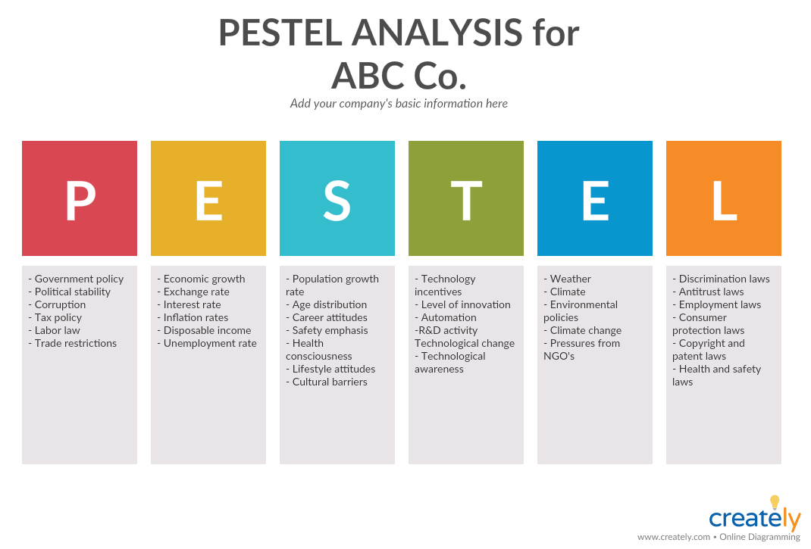
BUSINESS MODEL (…continued)
Notes:
PESTLE analysis is a tool that is used to identify and examine the external factors that affect a business. These macro environmental factors the analysis try to identify are
Political factors such as government policies, trading policies or elections
Economic factors such as economic trends, taxes, or import/export ratios
Social factors such as demographics, lifestyles, or ethnic issues
Technological factors like advancing technology or technology legislation
Legal factors such as employment laws or health and safety regulations
Environmental factors such as climate change or environmental regulations

Slide 6
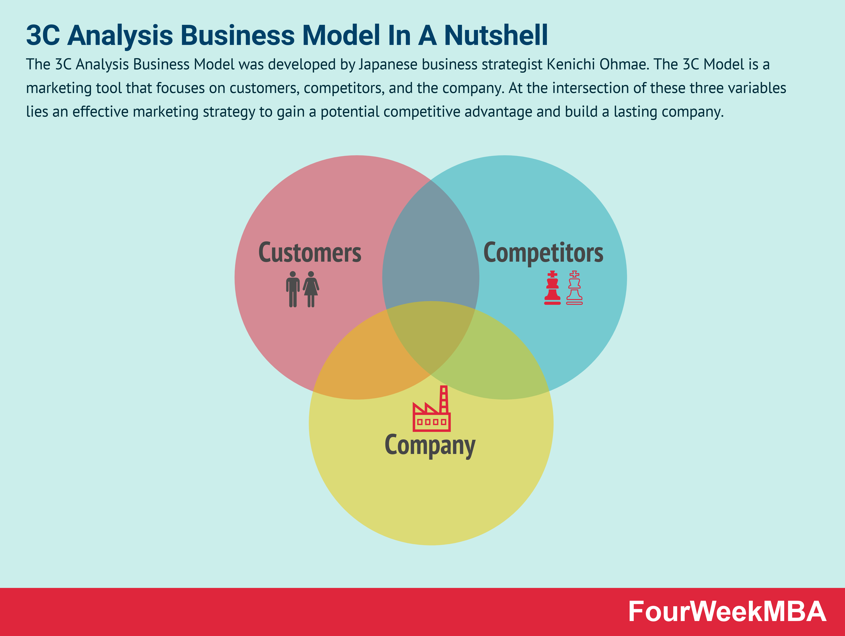
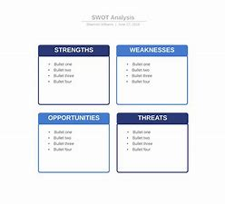
BUSINESS ANALYSIS MODEL (…continued)
Notes:
The 3C Model is a marketing tool that focuses on customers, competitors, and the company. At the intersection of these three variables lies an effective marketing strategy to gain a potential competitive advantage and build a lasting company.
The SWOT analysis is a fundamental tool in a BA’s arsenal. SWOT stands for strengths, weaknesses, opportunities, and threats.
SWOT analysis evaluates a business’s strengths and weaknesses and identifies any opportunities or threats to that business.
SWOT analysis helps stakeholders make strategic decisions regarding their business. The goal is to capitalize on strengths and opportunities while reducing the impact of internal or external threats and weaknesses.

Slide 7
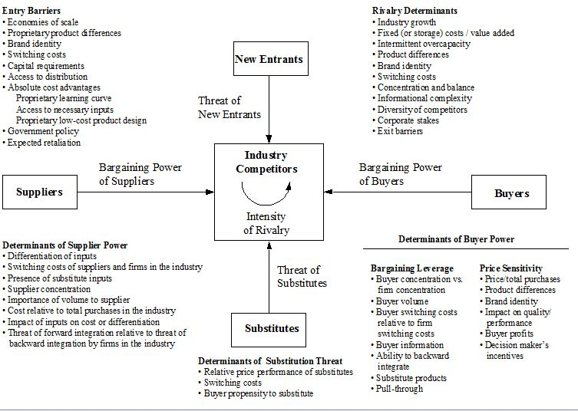
FIVE FORCES INDUSTRIAL ANALYSIS
Notes:
Michael Porter’s Five forces analysis framework analyzes an industry and more specifically, the external business environment of the industry.
They tell us whether or not we should enter an industry, and also if we enter it, then what can be the challenges faced by us.
The basis of the Five forces analysis model is competition. This model is used when we are entering an industry where already there is a lot of competition. Anytime we enter an industry, it is understood that there will be other players who might hold their own aces up their sleeves.
The key driving force behind Porter’s five forces model is to determine attractiveness of the industry. An industry is said to be attractive if the five forces are arranged in such a manner that they drive profitability.
Similarly, there are different ways in which a customer or a buyer can have high bargaining power over the supplier. In such cases, the industry tends to be unprofitable because you have to overcome the challenge of having the buying power over suppliers.

Slide 8
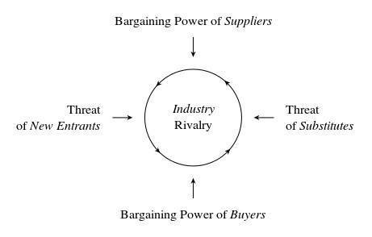
FIVE FORCES ANALYSIS MODEL
Notes:
Above is a simplified image of the model of Porter’s five force analysis. As the name suggests, there are five different forces which play a role in the industry. And these five forces affect each of the competitors present within that industry.
The industry attractiveness increases when there are barriers to entry. For example – in the import export business, a lot of barriers exist with regards to government policy. Thus, an established player will see new entrants as a lesser challenge as compared to an existing competitor. To avoid new entrants, and to keep the industry profitable, the industry needs several entry barriers in place.

Slide 9
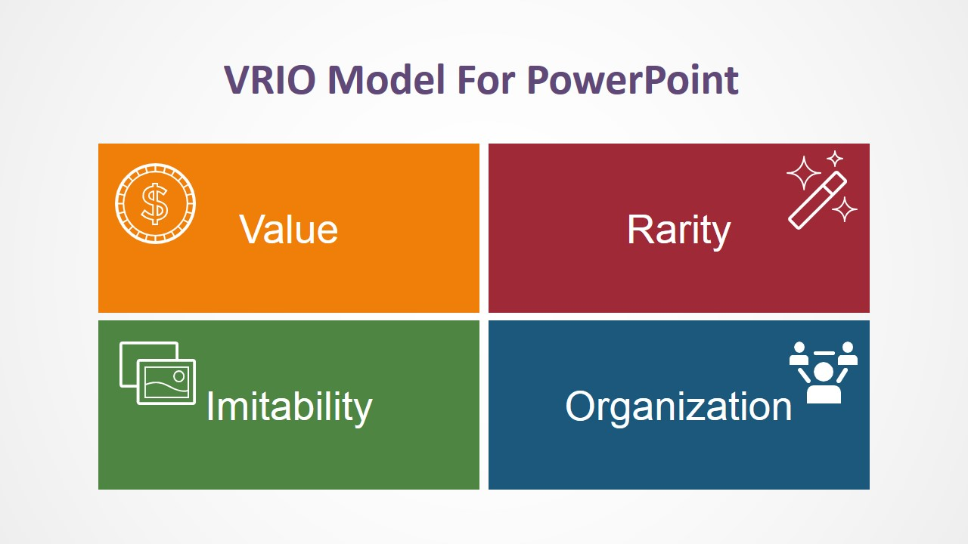
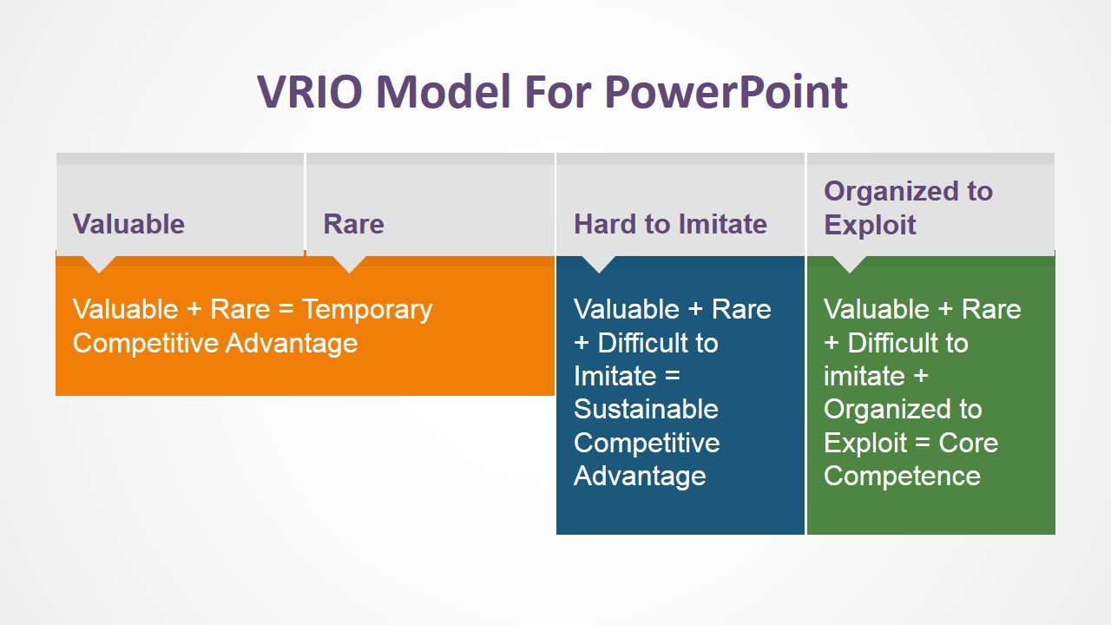
VRIO ANALYSIS
Notes:
The VRIO model is a strategic analysis framework applied during the internal analysis of strategic planning. The framework is based on the evaluation of resources and capabilities of an organization. VRIO is the acronym for the four (4) basic questions the framework evaluates over capabilities and resources:
Value: Does this resource/capability enables the organization to exploit an opportunity or block an external threat? If it does, the resources/capability can be considered a strength of the organization. The VRIO Value analysis generally starts with the review of the Value Chain of the organization, looking for assets that have optimized certain pieces of the chain. In most of the cases, this assets can be considered inside the Value concept of VRIO. Another interpretation of the Value concepts is for those resources/capabilities that increase the perceived value of the customer.
Rarity: Does control of this resource/capability in hands of a few (in the market)? The rarity concept of the VRIO framework requires that the resource/capability labeled meet the short supply and persistence over time condition. If these are not met, the resource/capability cannot generate a sustainable competitive advantage.
Imitability: Is the resources/capability difficult to imitate? Or Does this resources/capability generate a cost disadvantage to the competing organizations trying to obtain, develop, or duplicate it? Imitation can occur in two ways: by directly imitating the resource/capability or by providing the substituting with a comparable resource/capability.
Organization: Is the organization structured, built and able to exploit the resources/capability? The resource/capability do not guarantee any competitive advantage for an organization by itself. The form needs to be organized to capture the value from them. The organization is based around management systems, processes, policies ,structure and culture.

Slide 10
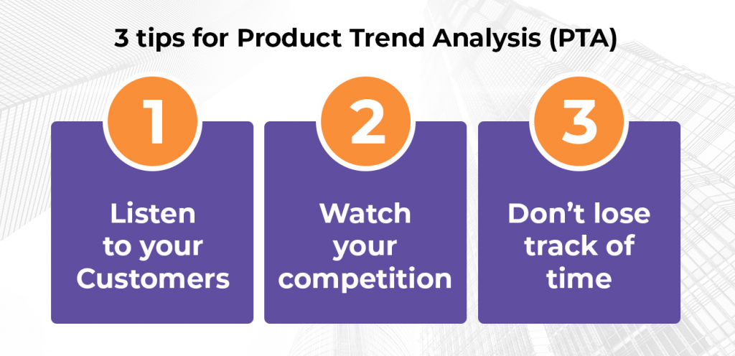
PRODUCT TREND ANALYSIS
Notes:
Product Trend analysis is an analysis of past and current consumer data related to a single product in order to extract insights about future market shifts and directions.
Product trend insights is used in order to identify the main market traits and the buyer persona’s related to each trait. This data can then be utilized to form the overall product marketing strategy and brand innovation plan.
Market trends are heavily influenced by customers’ habits and behaviour.
Performing market research and collecting customer experience data is a major part of analyzing and understanding how the market is reacting and what are the primary needs and wants of the consumers. This kind of data driven trend analysis will let you know what a brand has to do to stay ahead of the competition.

Slide 11
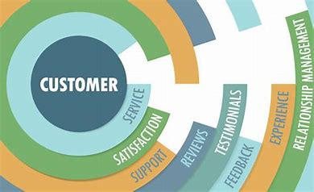
PRODUCT TREND ANALYSIS (…continued)
Notes:
Trend analysis of datasets is one kind of text mining procedure which is a part of natural language processing. Product trend analysis is basically the method of analyzing the reviews given by the customer to a particular product.
This paper, we have used various classifier's algorithms (such as, Naive Bayes, K-NN and SVM) to determine the positivity or negativity of the review datasets on recent market trends. It proposes that the trend of a particular product through which we can predict whether it will continue in the market or not. The whole database of this work is a collection of user reviews (such as, comments, testimonials, messages etc,) from various social sites.
Market trends analysis has a huge advantage in terms of monetization and profits. This approach also shows the comparison among these classifiers with respect to the feedbacks of market data analysis. Finally, these comparisons are also included movie reviews dataset. It shows that SVM classifier performs better analysis in terms of precision, recall and accuracy parameters on the above datasets compare to the widely used K-NN and Naïve Bayes machine learning classifiers.

Slide 12
REFERENCES
Johnson, M. W., Christensen, C. M., & Kagermann, H. (2008). Reinventing your business model. Harvard business review, 86(12), 57-68.
Magretta, J. (2002). Why business models matter.
Osterwalder, A., & Pigneur, Y. (2010). Business model generation: a handbook for visionaries, game changers, and challengers (Vol. 1). John Wiley & Sons.
Teece, D. J. (2010). Business models, business strategy and innovation. Long range planning, 43(2-3), 172-194.

